Slide 1




Progrès récents dans le transport de molécules au travers des membranes cellulaires ou
comment des molécules polaires de haut poids moléculaire peuvent traverser une barrière imperméable, sans systèmes de transport spécialisés
Sandrine Sagan, Laboratoire des Biomolécules, Paris
Sculpture (1967, Jean Marais), représentant Marcel Aymé en « passe-murailles », installée en 1989 sur la place éponyme, quartier Montmartre, Paris

Slide 2
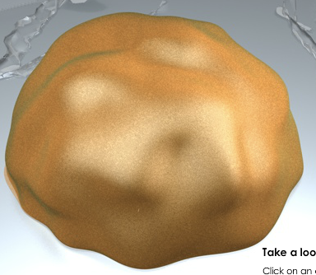
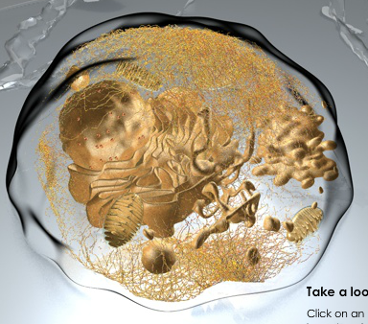
At every level of organization, a living organism must maintain homeostasis.
Electrochemical potential
Osmotic pressure
pH
Temperature
Red-ox balance
Cell membranes : barriers to uncontrolled diffusion

Slide 3
Description of the eucaryotic cell membrane
Polar substance
Nonpolar substance
Lipid content
Selective lipid coating
Lipid monolayer
Monomolecular layer
Lipid bilayer
First artificial membrane (liposome)
Lipid bilayer + protein layer
proteins associated with the polar heads of lipids
unitary tripartite membrane matching with electron microscopy images
Lipid bilayer protein layer
Lipid bilayer + moving proteins
Current mosaic fluid model
Adapted from Cell Biology by the Numbers, R. Milo & R. Phillips

Slide 4
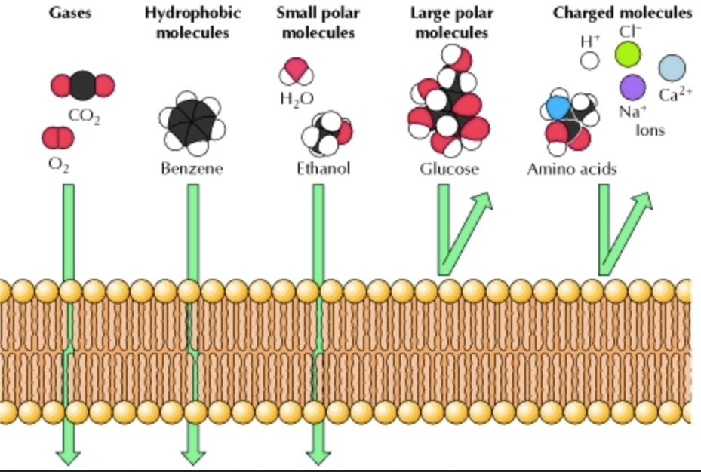
Lipid bilayer permeability
Passive diffusion
extracellular
4 nm
intracellular

Slide 5
Transport across cell membrane: how ?
water
lipophile molecules
water
glucose
ions
polar molecules
extracellular
Ions
Glucose
Amino acids
neurotransmitters
Energy
Simple Diffusion
Facilitated Diffusion
Active
transport
intracellular

Slide 6
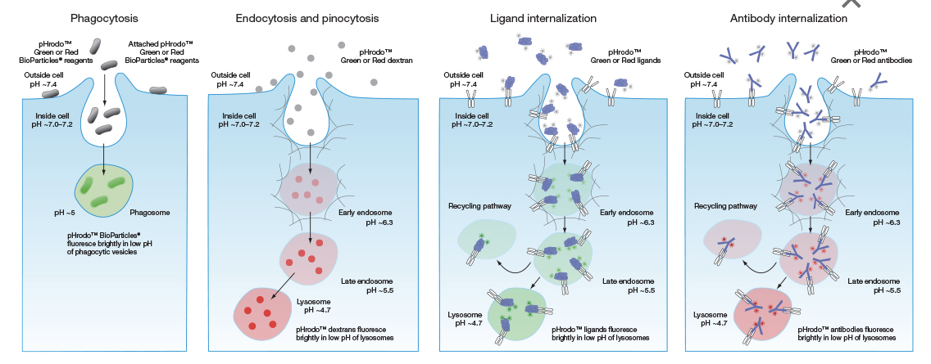
Active transport pathways at the level of the lipid bilayer
https://www.thermofisher.com/fr/fr/home/life-science/cell-analysis/cell-viability-and-regulation/endocytosis-exocytosis-and-phagocytosis.html

Slide 7
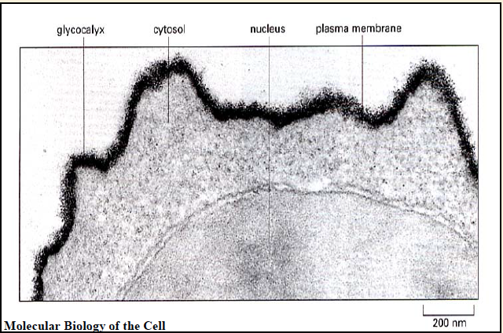
Cell membrane : more than just a lipid bilayer and proteins

Slide 8
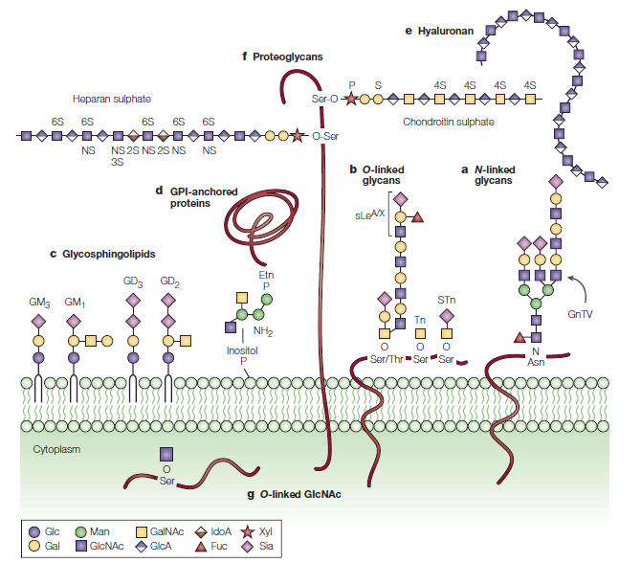
Cell membrane composition : lipids, proteins … and polysaccharides
-
-
-
Glycocalyx
Polysaccharides
Associated proteins
-
-
-
-
-
NEGATIVELY charged
Lipid Bilayer
Heterogeneous (lateral/transverse asymmetry)
Dynamic
HYDROPHOBIC boundary
Fuster, Nat. Rev. Cancer (2005) 5:526

Slide 9
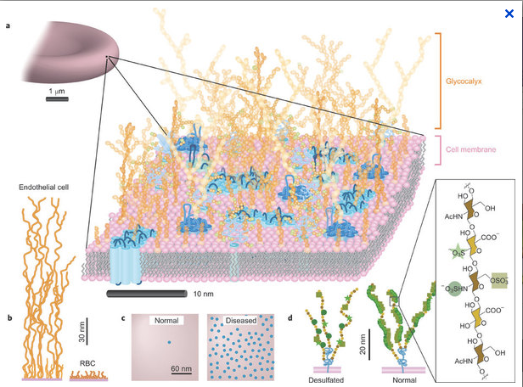
Cell membrane : many exploited portals of entry
Virus, bacteria
Growth factors, homeoproteins, toxins
Peptides (protein-transduction domains, cell-penetrating peptides …)
Viscous gel-like layer
Water and ions
Mager, Nat Chem (2011) 3:582

Slide 10
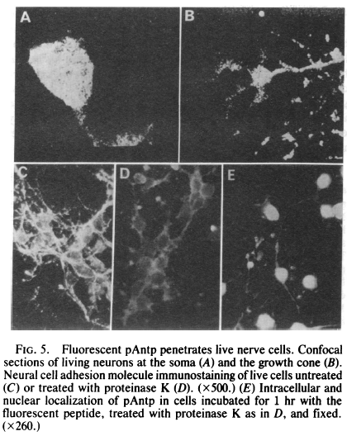
First evidence for cell transfer of an endogenous polypeptide
60 amino acids basic polypeptide derived from Antennapedia homeoprotein (transcription factor)
KRGRQTYTRYQTLELEKEFHFNRYLTRRRRIEIAHALCLTERQIKIWFQNRRMKWKKENKTKGEPGSGGEGDEITPPNSPQ
Carlier (2013) Biophys J, 105:667
Joliot, Prochiantz, Proc Natl Acad Sci USA. (1991) 88:1864

Slide 11
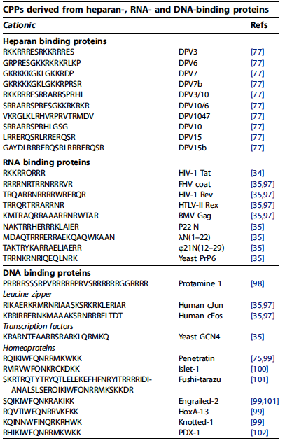
Cationic cell-penetrating peptides
Milletti, Drug Discovery Today. (2012) 17:850

Slide 12
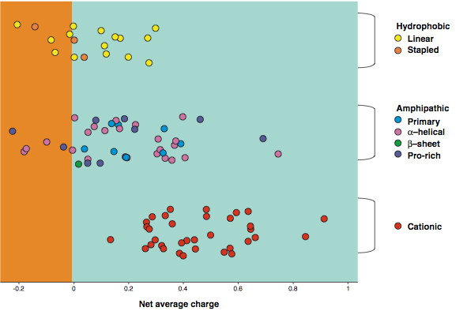
CPPs : no particular molecular and structural features
Milletti, Drug Discov Today (2012), 17:850

Slide 13
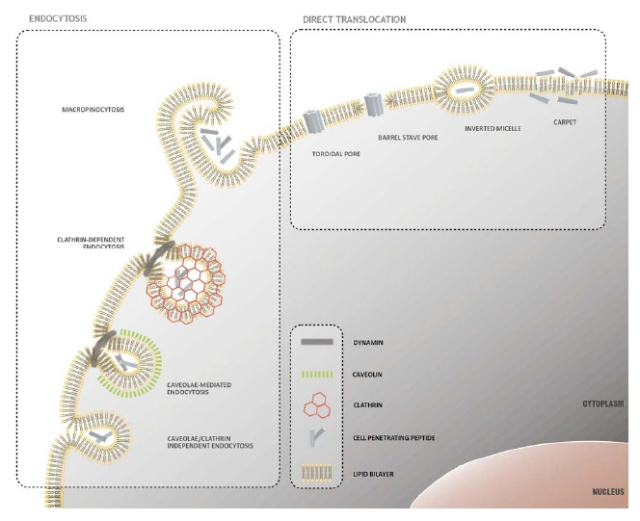
Internalization pathways for CPPs
Inverted micelle
Direct Translocation
Less energy-dependent, still observed at 4 °C (although decreased: altered membrane fluidity)
Macropinocytosis
Electroporation-like
Toroidal pore
Clathrin-dependent
endocytosis
Dynamin
Caveolin
Clathrin
CPPs
Lipid Bilayer
Caveolae-
mediated
endocytosis
Dynamin
Caveolin
Clathrin
CPPs
Lipid Bilayer
Cytoplasm
Endocytosis
energy dependent
blocked at 4 °C
Caveolae/Clathrin
independent
endocytosis
Nucleus
Different mechanisms occur simultaneously
Adapted from Trabulo, Pharmaceuticals (2010) 3:961

Slide 14
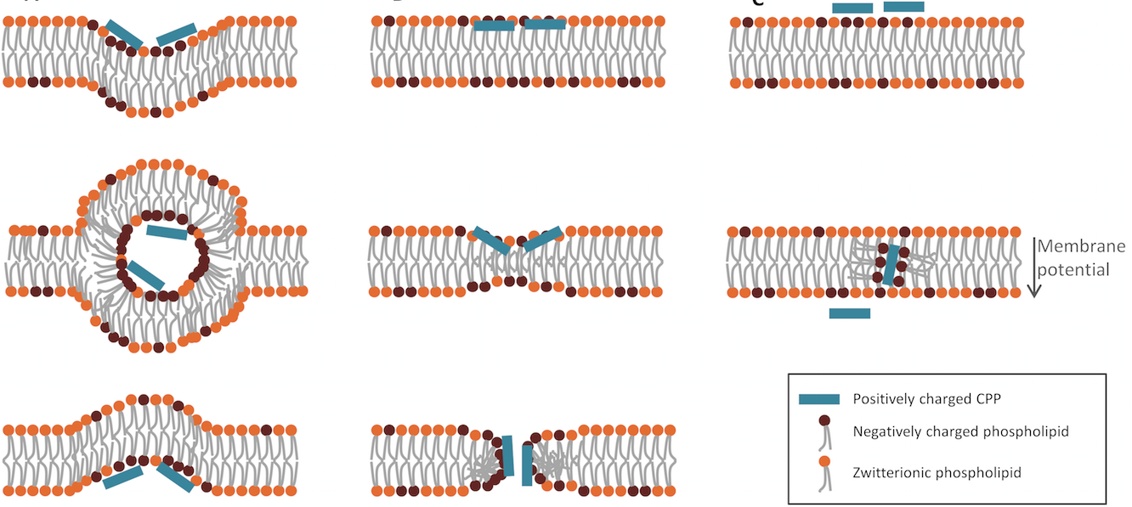
Hypothetical current models for translocation
Bechara, FEBS (2013) 587: 1693

Slide 15
Cell membrane : many exploited portals of entry
Focus on lipids
Mager, Nat Chem (2011) 3:582

Slide 16
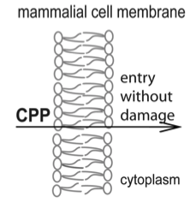
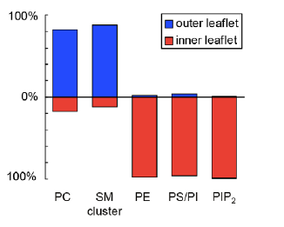
CPP passage does not damage cell plasma membrane
Net charge : 0
Net charge : negative
4 nm
Absence of cell toxicity
Nekhotiaeva, FASEB J (2004) 18: 394
Murate, J Cell Sci (2015) 128, 1627

Slide 17
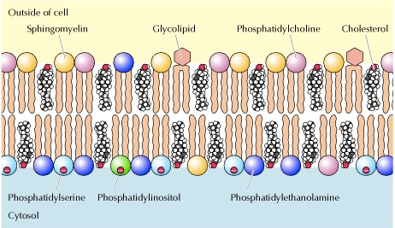
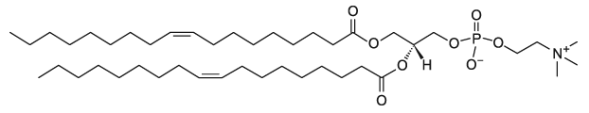
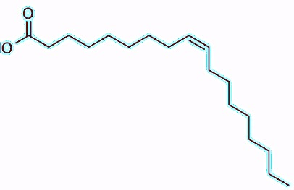
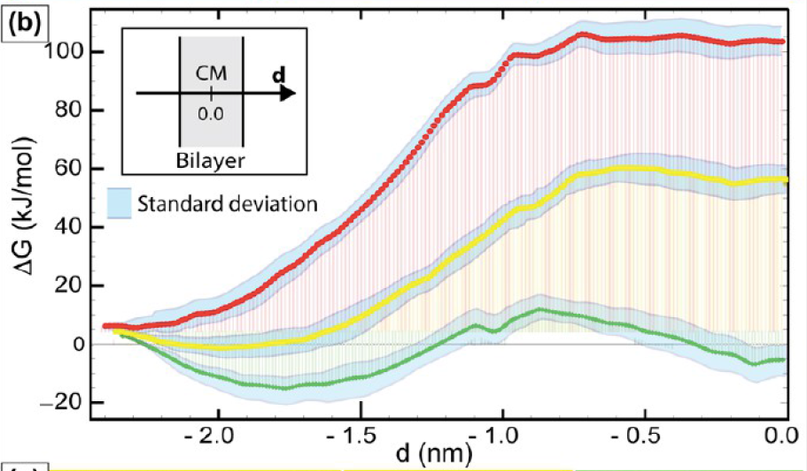
Membrane lipid partners for CPPs
Free energy profiles as functions of the distance of the center of mass of the TAT peptide from the center of mass of the lipid bilayer (DOPC, oleic acid)
DOPC (18:1 Δ9-cis PC)
Molecular Simulation Dynamics
1 TAT (YGRKKRRQRRR)
8700 water molecules
68 DOPC
48 oleic acid
H
Oleic acid (C18:1)
Protonated
COOH
Half Protonated
COOH
/ COO⁻
Deprotonated
COO⁻
Herce, JACS (2014) 18: 394

Slide 18
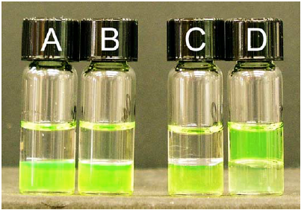
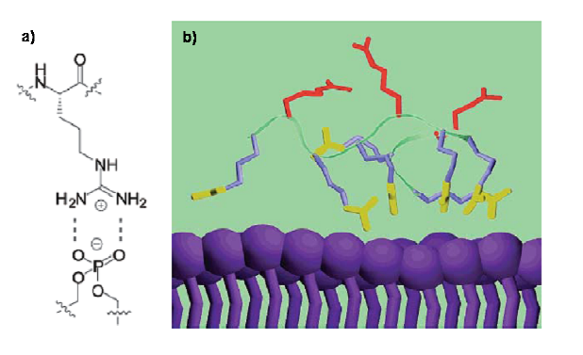
How does a cationic peptide penetrate a hydrophobic bilayer?
A, C : CF-Lys8 B, D : CF-Arg8
Octanol/water partition
without with sodium laurate (C12:0)
counter-ion phase transfer
bidentate hydrogen bonds
Rothbard, Adv Drug Del Rev (2005) 57:495

Slide 19
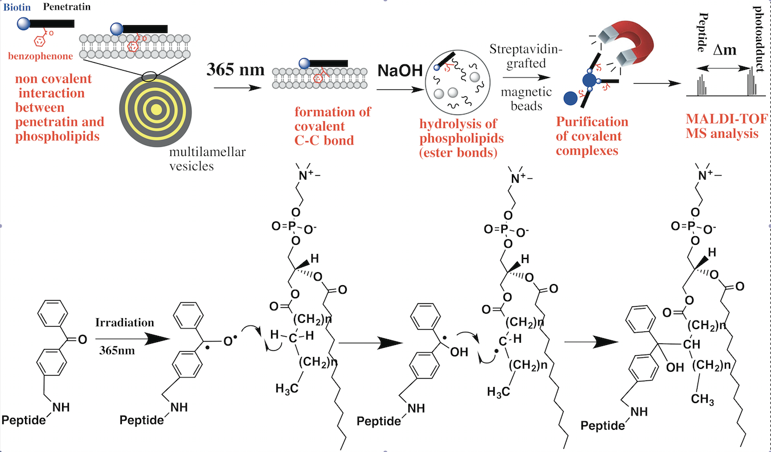
Lipid partners for translocation - Model membranes
Jiao, Angew Chem (2017) 56:8226

Slide 20
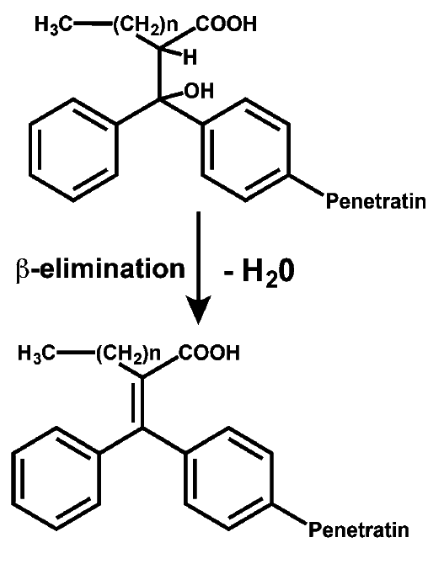

Exploiting benzophenone photoreactivity to probe CPP insertion depth and surroundings
Penetratin has a preference for disordered phases :
Negatively charged polar heads (PG > PC)
Unsaturated fatty chains (C18:2 > C18:1 > C18)
Short saturated fatty chains (C14 > C18)
PC : photolabeling in α of carboxylate (water/lipid interface)
Pure PC vesicles
+
+
+
-
-
-
+
+
+
-
-
Jiao, Angew Chem (2017) 56:8226

Slide 21
Cell membrane : many exploited portals of entry
Focus on proteins
Mager, Nat Chem (2011) 3:582

Slide 22
Cell membrane : many exploited portals of entry
Membrane proteins expose thiol moieties to the extracellular milieu (exofacial thiols).
Thiols present in these proteins can be in reduced (-SH) or oxidized (S-S) form.
Torres, Trends Biotech (2012) 30:185

Slide 23
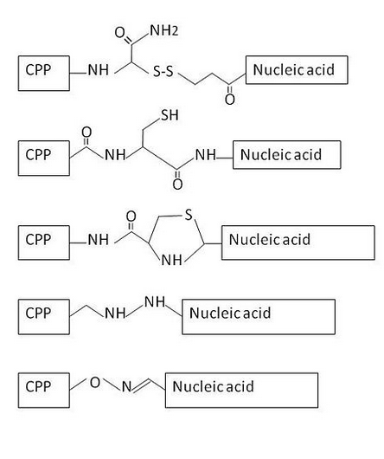
Impact of cell surface thiols in CPP internalization
CRWRWKCCKK (CyLoP-1)
Cys-rich CPP (from crotamine toxin)
Disulfide conjugated CPP-cargo
S-S

Slide 24
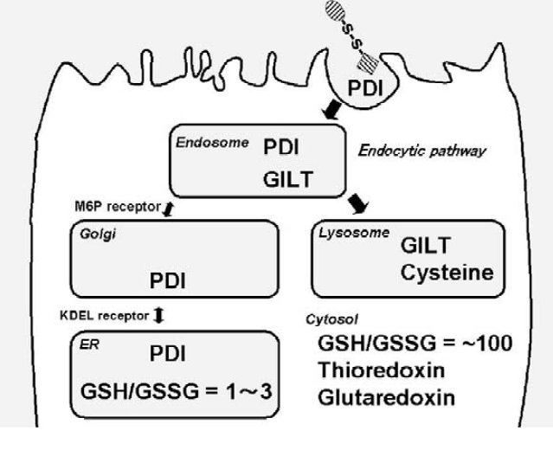
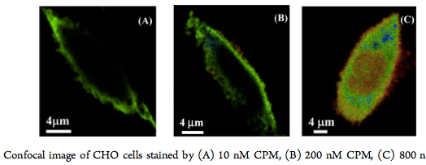
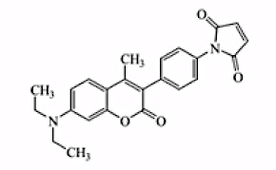
Exofacial cell thiols
GSH ≈1 mM
Saito, Adv Drug Del Rev (2003) 55:199
PDI : Protein Disulfure Isomerase
GILT : Gamma-interferon-inducible lysosomal thiol reductase
500 ps
M CPM
7-(diethylamino)-3-
(4-maleimidophenyl)-4-methylcoumarin
Ghosh, J Phys Chem B (2014), 118:2949
Notes:
Conversion de Cystine en cystéine est évaluée à 5nmoles/heure

Slide 25
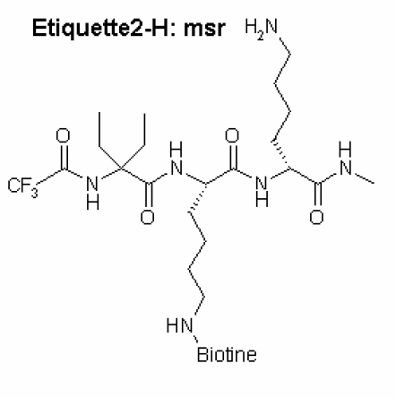
Impact of cysteinyl residues on CPP uptake efficiency
Study of the internalization efficacy of two CPP sequences without or with additional Cysteinyl residues in reduced or oxidized forms.
Aubry, FASEBJ (2009) 23: 2956-2967
Notes:
Dithiodipyridine pour cycliser les peptides. Suivi par HPLC

Slide 26
Methods to measure absolute intracellular peptide amounts
MALDI-TOF MS
Fluorescence spectroscopy
Burlina, Angew Chem. (2005) 44:4244; Nat Protoc. (2006) 1:200
Illien, Sci Rep. (2016) 6:36938

Slide 27
Impact of cysteinyl residues on CPP uptake efficiency
Same CPP sequence with different internalization efficacy
Aubry, FASEBJ (2009) 23: 2956-2967

Slide 28
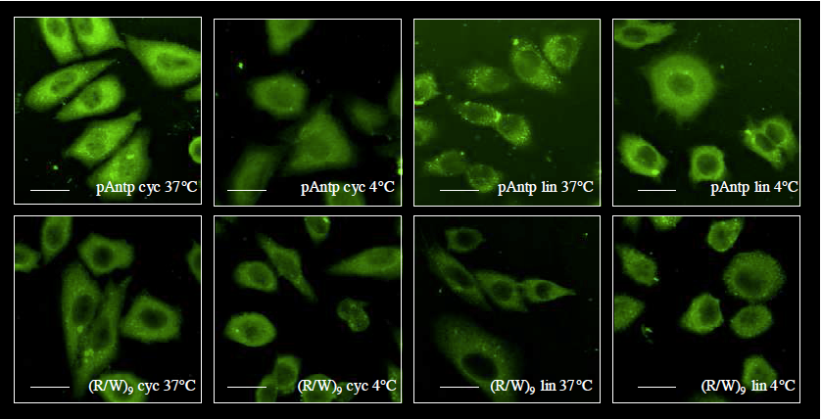
Impact of cysteinyl residues on CPP uptake efficiency
X : acetamide
Identical quantities are measured after chemical modification of membrane thiols
Aubry, FASEBJ (2009) 23: 2956-2967

Slide 29
Disulfide bridge enhances CPP uptake efficiency
X : acetamide
Aubry, FASEBJ (2009) 23: 2956-2967

Slide 30
Exploiting cell surface thiols to enhance cellular uptake
Laurent, Matile, JACS Au 2021, 1, 710−728

Slide 31
Cell membrane : many exploited portals of entry
Focus on polysaccharides
Mager, Nat Chem (2011) 3:582

Slide 32
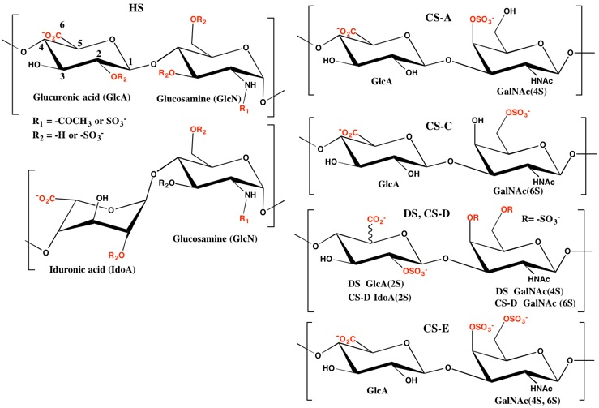
Role of negatively charged cell-surface polysaccharides in CPP uptake

Slide 33
Internalization efficacy is sequence-dependent
WT CHO cells
amount (pmoles) in 1 million cells
5 μM peptide concentration
Penetratin RQIKIWFQNRRMKWKK (+7)
R9 RRRRRRRRR (+9)
Tat YGRKKRRQRRR (+8)
RW9 RRWWRRWRR (+6)
Jiao, J Biol Chem (2009) 284:33957

Slide 34
Cell-surface HS and CS contribute differently to CPP internalization
WT CHO cells
HS-, CS-deficient CHO cells
amount (pmoles) in 1 million cells
5 μM peptide concentration
Penetratin RQIKIWFQNRRMKWKK (+7)
R9 RRRRRRRRR (+9)
Tat YGRKKRRQRRR (+8)
RW9 RRWWRRWRR (+6)
Jiao, J Biol Chem (2009) 284:33957; Bechara, FASEB J (2013) 27:738

Slide 35
GAGs and lateral heterogeneity of the lipid bilayer
Sphingomyelin and Cholesterol-enriched domains
Cellular signalling
Lipid and protein sorting
Membrane trafficking
Proteoglycan
ceramide
SM
Chol
Sphingomyelinase
PC
Exclusion of cholesterol
Exclusion of membrane proteins
Destabilization of the bilayer (curvature, defects in lipid packing, …)

Slide 36
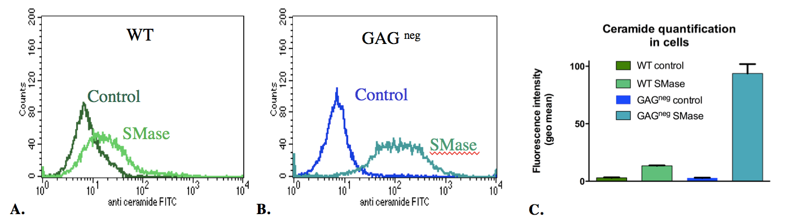
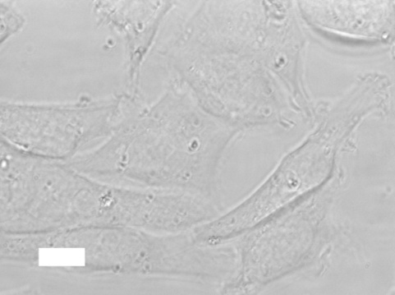
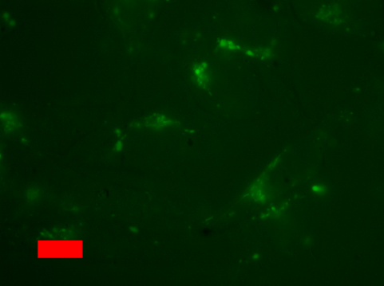
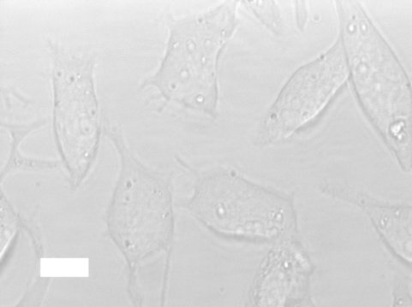
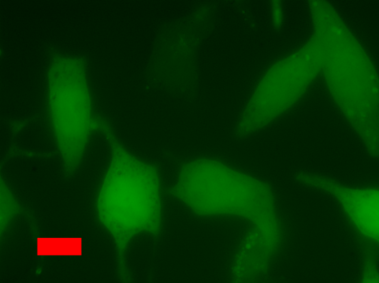
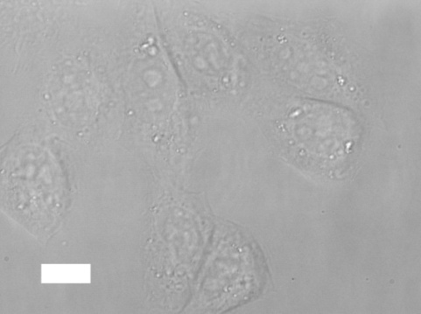
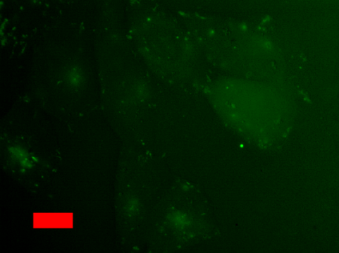
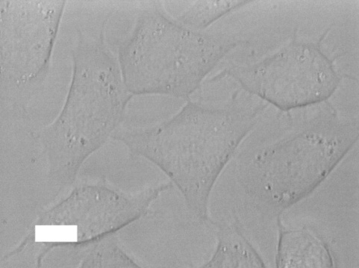
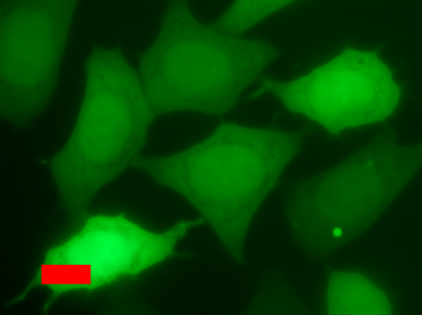
Detection of sphingomyelin hydrolysis in the cell membrane
Control
+SMase
WT
4.4 KDa Dextran-FITC: fluid-phase endocytosis marker
GAG^{neg}
Bechara, Cell Mol Life Sci (2015) 72:809

Slide 37
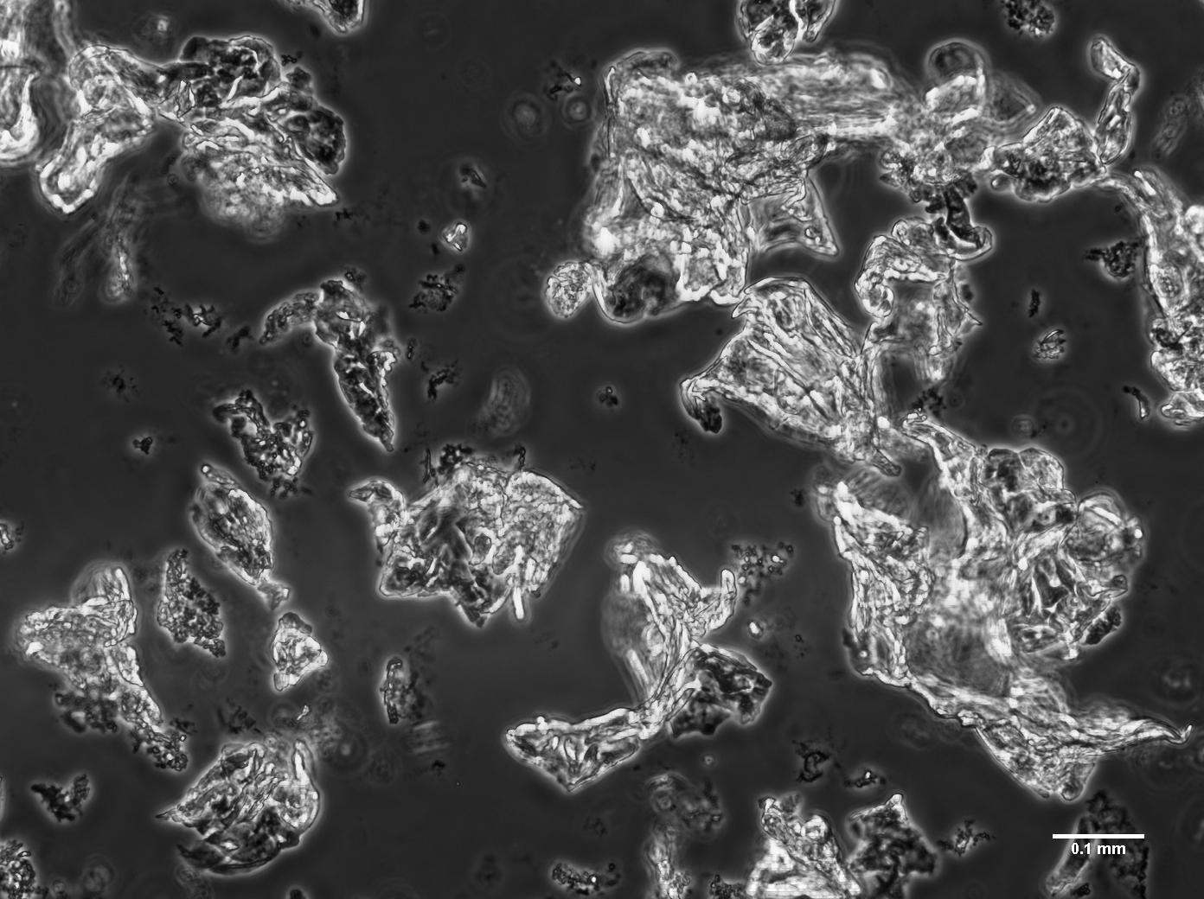
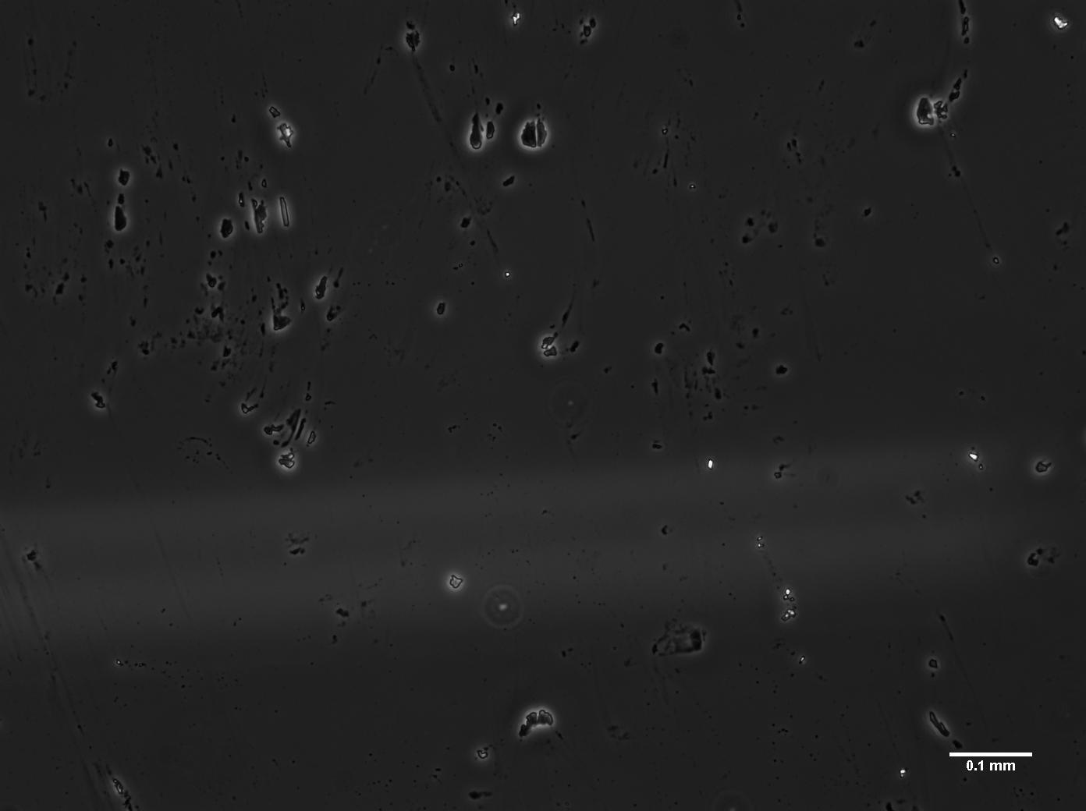
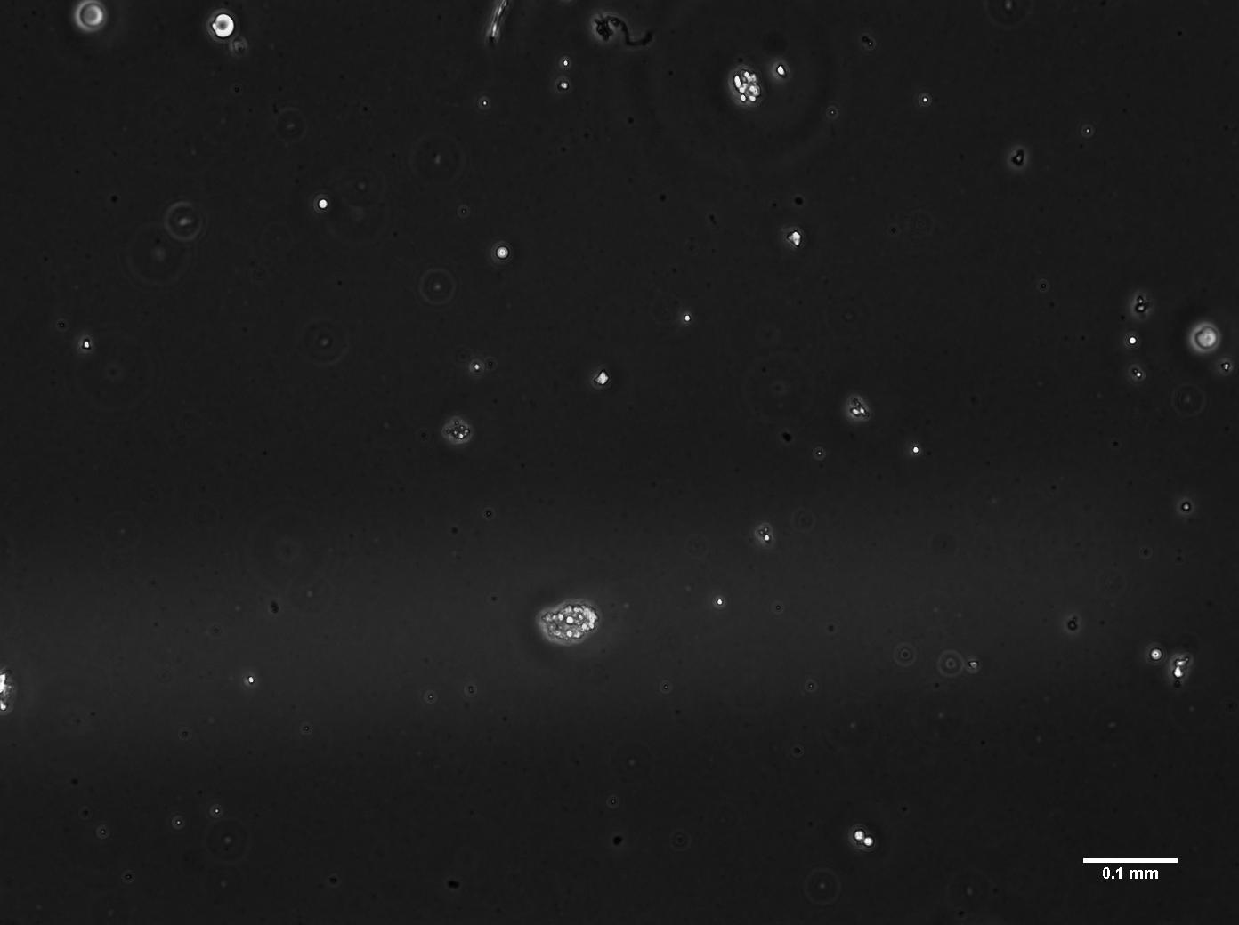
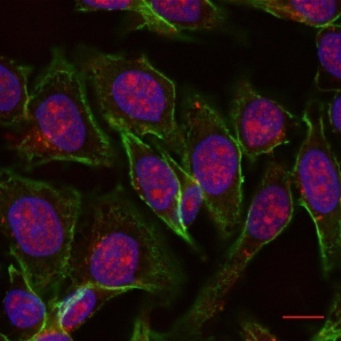
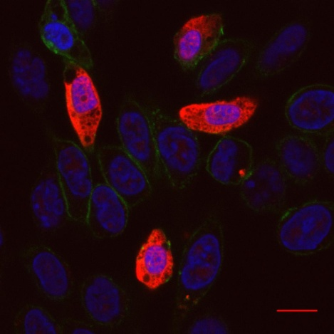
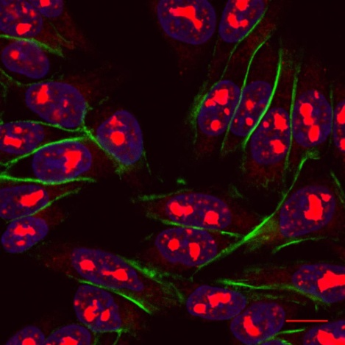
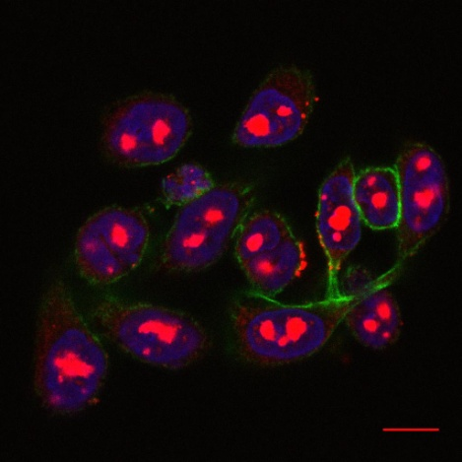
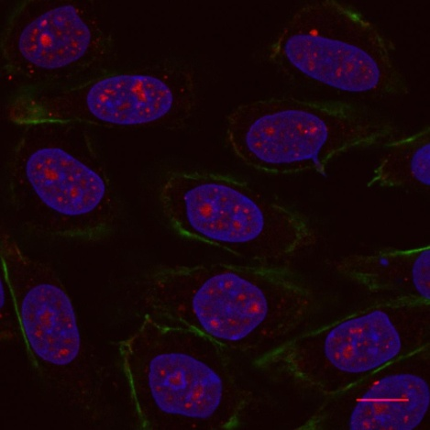
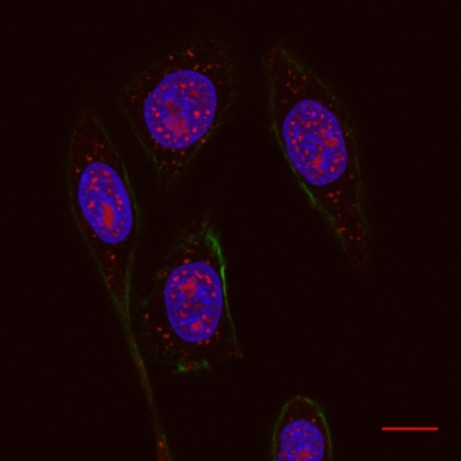
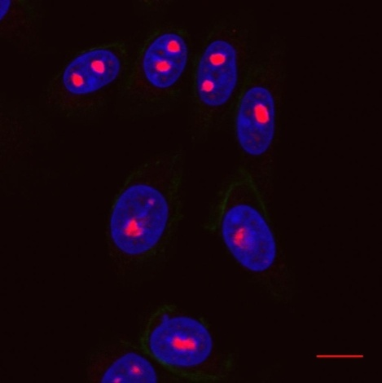
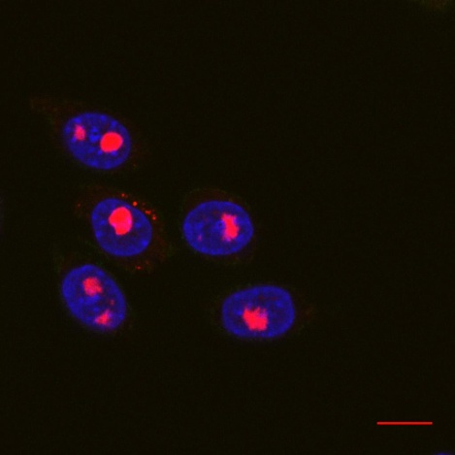
Sphingomyelin hydrolysis: impact on CPP uptake
Penetratin (2W; +7)
CS C
TAT peptide (0W; +8)
GAG-aggregates
No GAG-aggregates
Control
+SMase
Control
+SMase
WT
GAG^{neg}
Red: CPP; Green: Actin filaments; Blue: Nucleus
Scale bar: 10μm
Bechara, Cell Mol Life Sci (2015) 72:809

Slide 38
Sphingomyelin hydrolysis: quantification of CPP uptake
SM hydrolysis
increases uptake, mainly driven by GAGs
n ≥ 6 independent
10⁶ cells, 1 hour incubation, 37 °C
Bechara, Cell Mol Life Sci (2015) 72:809

Slide 39
Role of Trp in peptide internalization
CS C
GAG-aggregates
No GAG-aggregates
Penetratin (2W; +7)
TAT peptide (0W; +8)
Scale bar: 10μm
Bechara, Cell Mol Life Sci (2015) 72:809

Slide 40
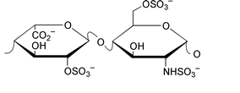
In vitro binding to GAGs: Thermodynamics
In vitro binding to GAGs: Thermodynamics of Trp-rich peptides
ITC: Injection of Heparin into peptide, 37 °C
HI, average mass 12 kDa, 100 charges/chain
Main disaccharide motif of heparin
a: facial amphiphilicity
n: non facial amphiphilicity
Walrant, BBA-Biomemb (2020) 1862(2):183098

Slide 41


In vitro binding to GAGs: Thermodynamics
Trp improves GAG-dependent entry via ionpair-π interactions
DFT calculations
Antonio Frontera
Walrant, BBA-Biomemb (2020) 1862(2):183098
Khemaissa, Crystals (2021) 11(9), 1032

Slide 42
What we do really know is still little
Current and future research
Role of GAGs in internalization
Making targeting cell-penetrating peptides
Electrostatics
H-Bonding
CPP
-
-
-
-
-
-
-
-
-
-
-
-
-
Hydrophobic
-
-
-
-
-
-
-
-
-
-
-
-
?
Insertion
Destabilization
Internalization
Cardon et al., bioRXiv (July 2021) A cationic motif in Engrailed-2 homeoprotein controls its internalization via selective cell-surface glycosaminoglycans interactions
Walrant, Acc Chem Res (2017)

Slide 43



Acknowledgments
Collaborators
Alain Joliot (Institut Curie - U932)
Antonio Frontera (University of the Balearic Islands)
Chrystel Lopin-Bon (ICOA, Orléans)
Sébastien Cardon (PhD)
Bingwei He (PhD)
Chen-Yu Jiao (PhD)
Soline Aubry (PhD)
Cherine Bechara (PhD)
Sonia Khemaissa (PhD)
Ludovic Carlier
Astrid Walrant
Olivier Lequin
Fabienne Burlina
Gérard Chassaing
Gérard Bolbach
Françoise Illien
Delphine Ravault
Emmanuelle Sachon
Sophie Cribier
Nicolas Rodriguez

Slide 44
Cell pH
Cell structure | pH
cytosol | 7.3
endoplasmic reticulum | 7.3
Golgi apparatus | 6.5
lysosome | 4.5
mitochondria | 8.0 (matrix) 7.1 (IMS)
nucleus | 7.3
peroxysome | 7.0
secretory vesicle | 5.5
Cho, J Pharm Sci (2002) 91: 903

Slide 45

Targeting cell-surface GAGs to improve
cell-specific CPP internalization
Penetratin
HS-binding
CS-binding
HS-Penetratin
CS-Penetratin
Quantity of intracellular peptide (picomoles)
HS/CS-deficient HS/CS-A, C HS/CS-E enriched CS-E enriched
Bingwei He, unpublished

Slide 46
Exploiting benzophenone photoreactivity to probe CPP insertion depth and lipid surroundings
Jiao, Angew Chem (2017) 56:8226

Slide 47

Internalization efficacy of CPPs: a quantitative MS approach
10⁶ cells
Biotin
GGGG
CPP
Biotin
GGGG
CPP
Non deuterated Glycine
Bideuterated Glycine
Washings
8 u
Peptide degradation
Intact Peptides
Cell Lysis
(+ [²H]CPP in lysis buffer)
% Intensity
1160
1413
1666
1919
Purification
(Streptavidin-coated magnetic beads)
m/z
Burlina, Angew Chem Int Ed Engl (2005) 44:4244; Nat Protoc. (2006) 1:200

Slide 48

Internalization efficacy of CPPs: a quantitative fluorescence approach
Illien, Sci Report (2016) 6:36938.

Slide 49

Involvement of cell-surface GAGs in Penetratin internalization
Penetratin: RQIKIWFQNRRMKWKK
WT
HS-, CS-deficient
WT
GAG^{def}
37°C
Penetratin concentration (μM)
Jiao, J Biol Chem (2009) 284:33957

